Slide 1
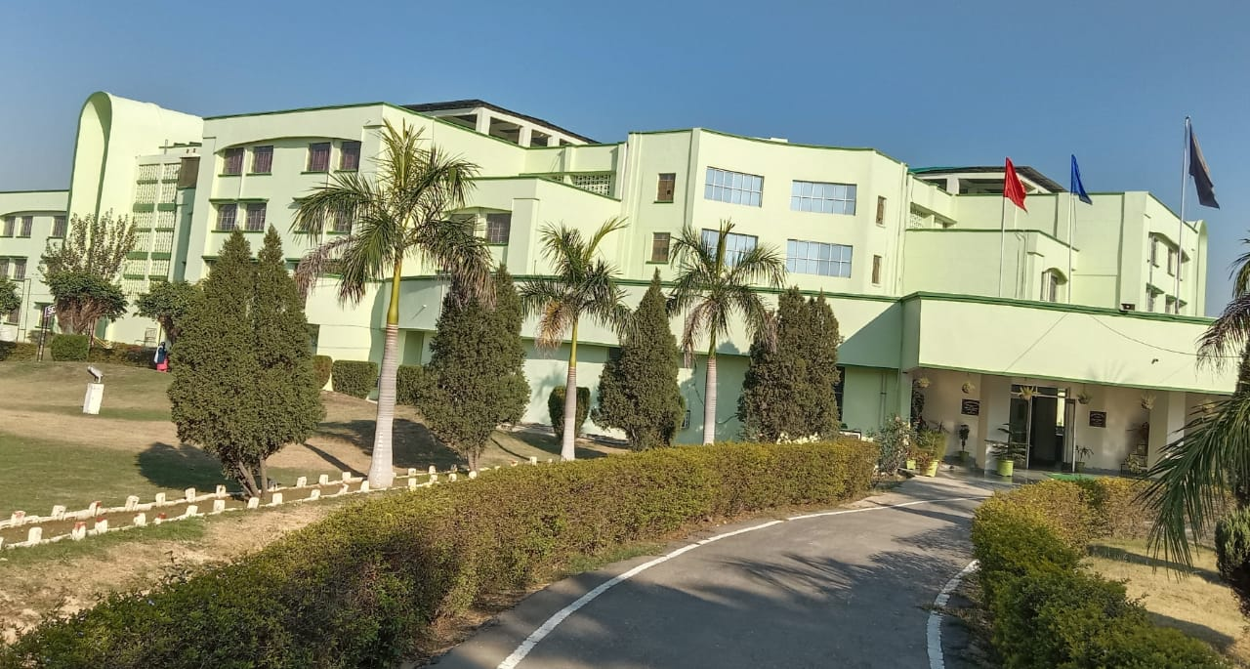
ARMY PUBLIC SCHOOL, PATIALA
Co- Curricular Activities (Session 2022-23)

Slide 2
April
Theme- Nature
“The Earth laughs in flowers”
S.No | Activity | Class
1. | Hindi Calligraphy Competition | VI
2. | World Health Day
2. | Awareness campaign for pollution free environment: Pledge (Nature) Globe Making Competition Plant a Sapling on the occasion of earth day Assembly Presentation | VI –IX
3. | AWES RAISING DAY Musical Tribute to AWES | -
4. | A Tribute to AWES- Painting Competition | VI
5. | A Tribute to AWES- Declamation Competition

Slide 3
May
Theme- Mother
“The loveliest Masterpiece of the Heart of God is the Heart of a Mother”
S.No | Name of the Activity | Class
1. | English Calligraphy Competition | VII
2. | Collage Making Competition-Labour Day | VIII
3. | Making Thank You Card for any ‘one’ community Helper-Labour Day | IX
4. | World Hand Hygiene Day Celebration – Teacher’s Talk Hand Hygiene Campaign | - VI-IX
5. | Card Making-Mother’s Day | VI
6. | Photo Frame Making Competition- Mother’s Day | VII
7. | Hindi Poetry Recitation- Mother’s Day | VIII

Slide 4
June
Theme- Environment
“Nature is not a place to Visit.. It is a Home”
S.No | Activity | Class
1. | Nature Photography Competition | VI
2. | Teacher’s Talk (World Environment Day | -
3. | Environment related projects (Recycling; Making homemade bird feeder; Composting) | VII
4. | Poster Making Competition- Environment Day | VIII
5. | Display of Yoga Asanas by Students- Yoga Day | -
6 | Poster Making Competition(Yoga Day) | IX

Slide 5
July
Theme- Kargil Vijay Diwas
“Kargil- A story of Pain and Pride”
S.No | Activity | Class
1. | Hindi Calligraphy Competition | VIII
2. | Slogan Writing- World Population Day | VI
3. | Solo Instrumental Competition & Solo Song Competition | VI-VII
4. | Quiz- Kargil War | VIII
5. | English Debate | IX
6. | World Conservation Day-Best out of Waste | IX
7. | Non- Gas Cooking | VII

Slide 6
August
Theme- Azadi Ka Amrit Mahotsav
“At the stroke of the midnight hour, when the world sleeps, India will awake to life and freedom- Pandit Jawaharlal Nehru”
S.No | Activity | Class
1. | Paper Craft Competition- (Independence Day) | VI
2. | Skit (Independence struggle) | VIII
3. | Rakhi Making Competition | VII
4. | Veer Gatha Competition | VI
5. | Instrumental music | -
6. | Science Quiz competition | IX
7. | English Spell bee | VIII
8. | Painting competition | VIII
9. | Video-Awareness Campaign - National Sports Day | XI

Slide 7
September
Theme- Hindi Diwas
“Mann Ki Bhasha, Prem Ki Bhasha.. Hindi Hai Bharat Jan Ki Bhasha”
S.No | Activity | Class
1. | Teacher’s Day- Card Making Competition | IX
2. | Speech- Importance of Teachers | XI
3. | Skit (Teacher’s Day) | -
4. | Hindi Diwas- Teacher’s Talk | -
5. | Hindi Diwas- Doha Recitation | VI
6. | Hindi Diwas -Kavi Samelan/ Kavita Gayan | VII
7. | Hindi Diwas -Slogan Writing Competition | IX-X
8. | Hindi Diwas- Debate | VIII

Slide 8
October
Theme- Rashtriya Ekta Diwas
“Ek Bharat, Shreshth Bharat ”
S.No | Activity | Class
1. | Gandhi Jayanti- Poster making competition | VII
2. | Gandhi Jayanti- English Debate | XI
3. | International Girl child day (Hindi Declamation) | VI
5 | Rashtriya Ekta Diwas- Pledge | -
6. | Rashtriya Ekta Diwas Skit | VIII
7. | Rashtriya Ekta Diwas English Declamation | VII

Slide 9
November
Theme- Children: Spreading Joy Everywhere
“Every child is a Different kind of flower and Together they make this world a Beautiful Garden”
S.No | Activity | Class
1. | Children’s Day Skit | -
2. | Musical Item By Teachers- Children’s Day | -
3. | Intra Class One Act Play Competition | VIII
4. | Art And Science Exhibition | VI- XII
5. | Spell Bee (Hindi) | VII
6. | Spell Bee (English) | IX
7. | Extempore (English) | XI
8. | Extempore (Hindi) | VI

Slide 10
December
Theme- MATHEMATICS
“The Only way to LEARN Mathematics is to DO Mathematics”
S.No | Activity | Class
1. | Mathematics Wizard(quiz) | VI -IX
2. | Indian Armed Forces Flag Day –Slogan Writing Competition | IX
3. | Flower Arrangement Competition | VI
4. | English Debate | VIII

Slide 11
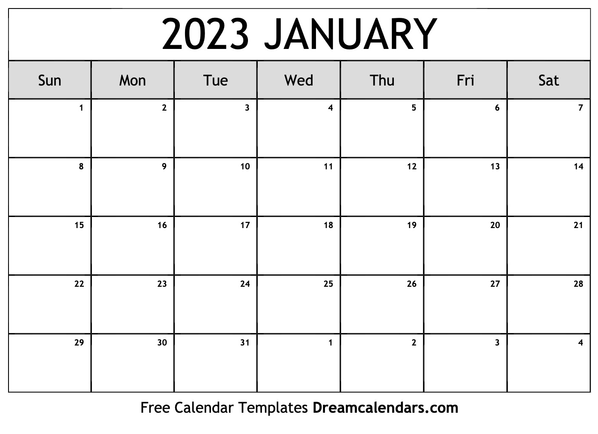
January
Theme- Republic Day
“Be the change you want to see in the world- Mahatma Gandhi ”
S.NO | Name of the Activity | Class
1 | Republic Day QUIZ | VIII
2 | Republic Day – Painting Competition | IX
3 | Republic Day- Musical Items | -
4 | English Extempore | IX

